Slide 1
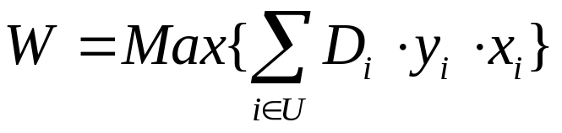
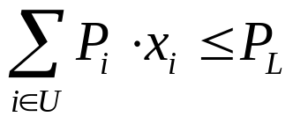
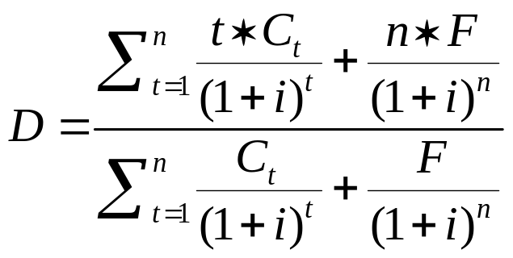
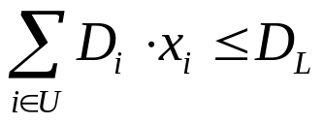
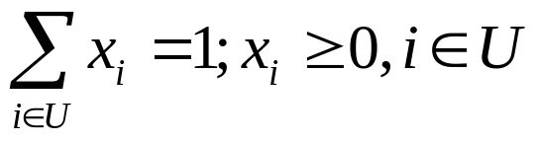





To Maximize Returns By Duration Matching
The max yield rate:
Restrictions:
1)
2)
3)
Duration:
t : Time of Cash Flow
: Cash Flow
F : Par Value
n : Maturity
i : Current Market Rate
: duration of bond i
: yield rate of bond i
: percentage of bond i
: issue value of bond i

